Slide 1
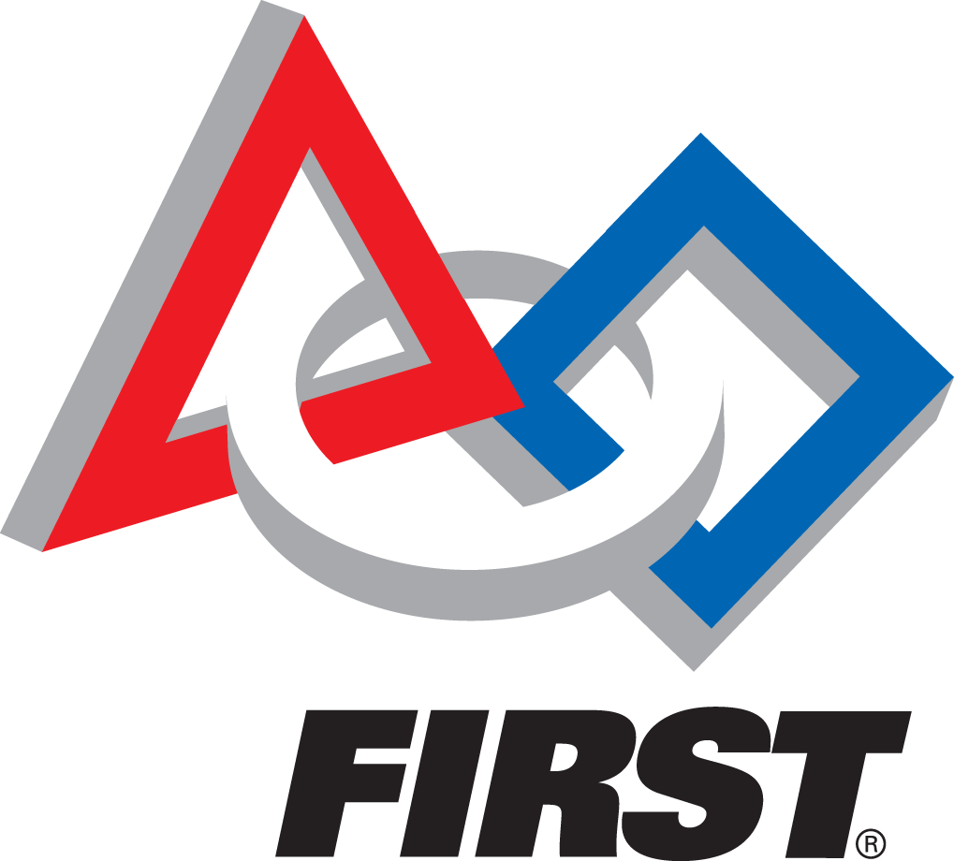

Robotics and Engineering
FIRST Team 461 Westside Boiler Invasion

Slide 2
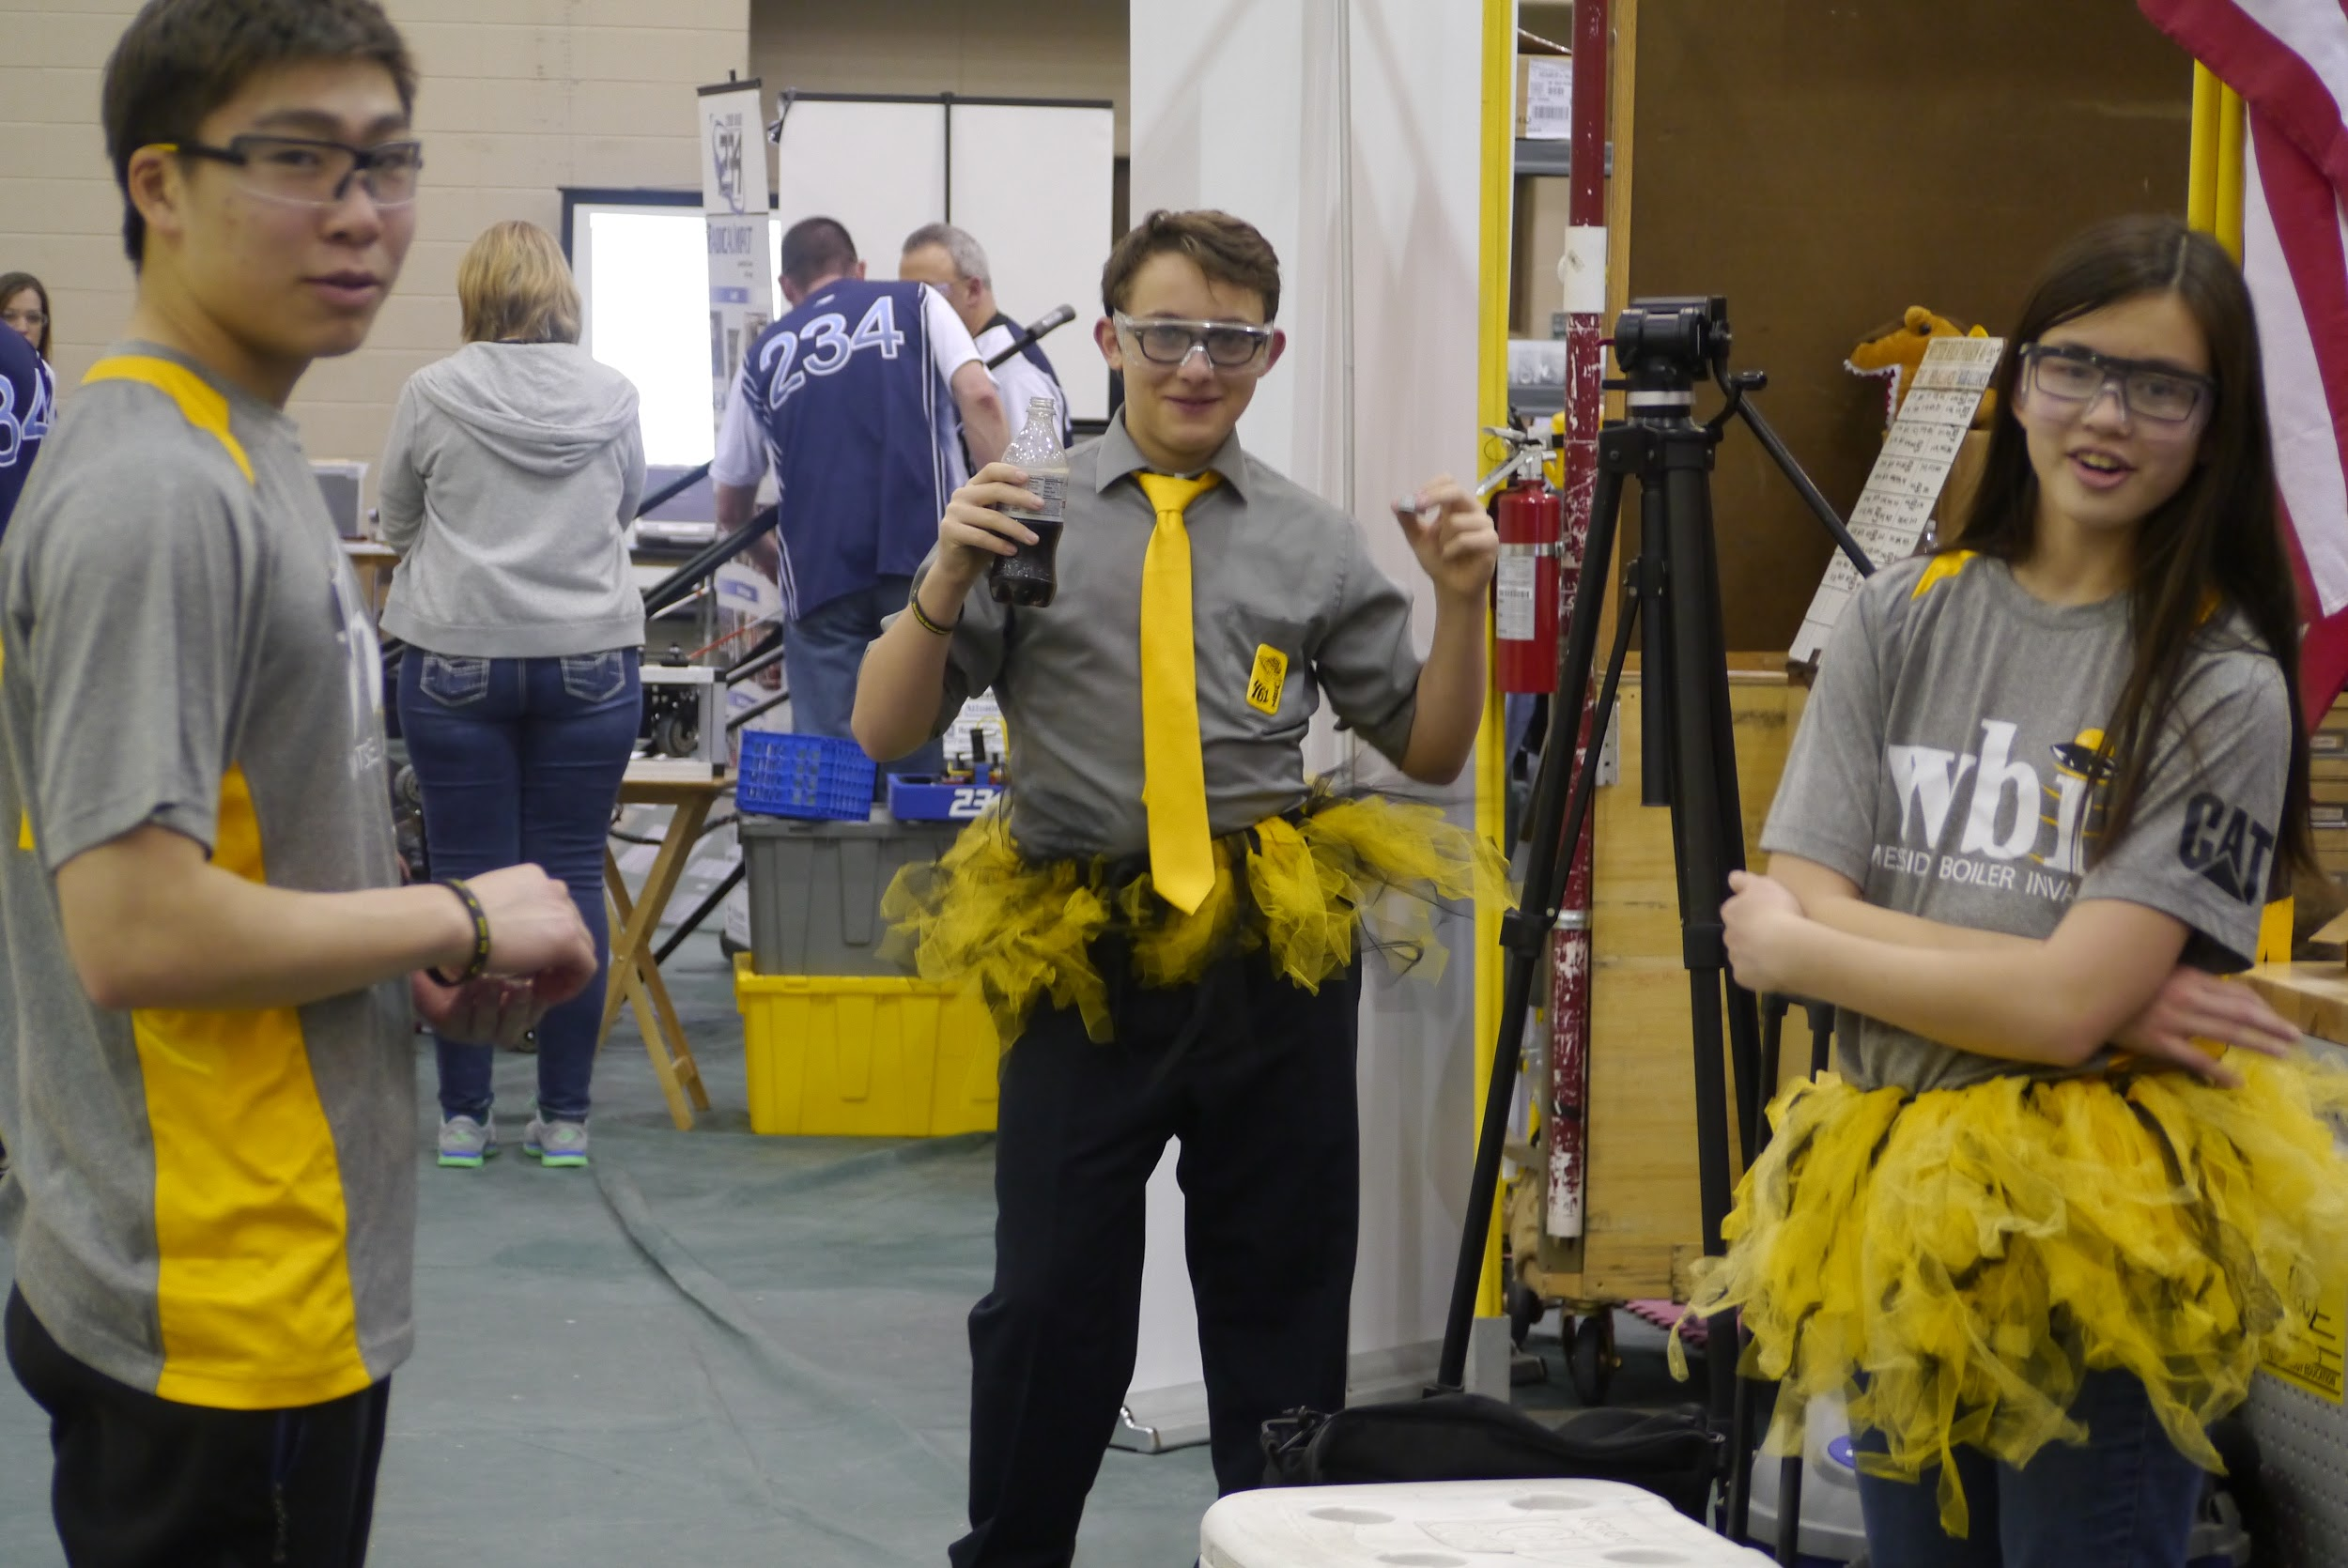
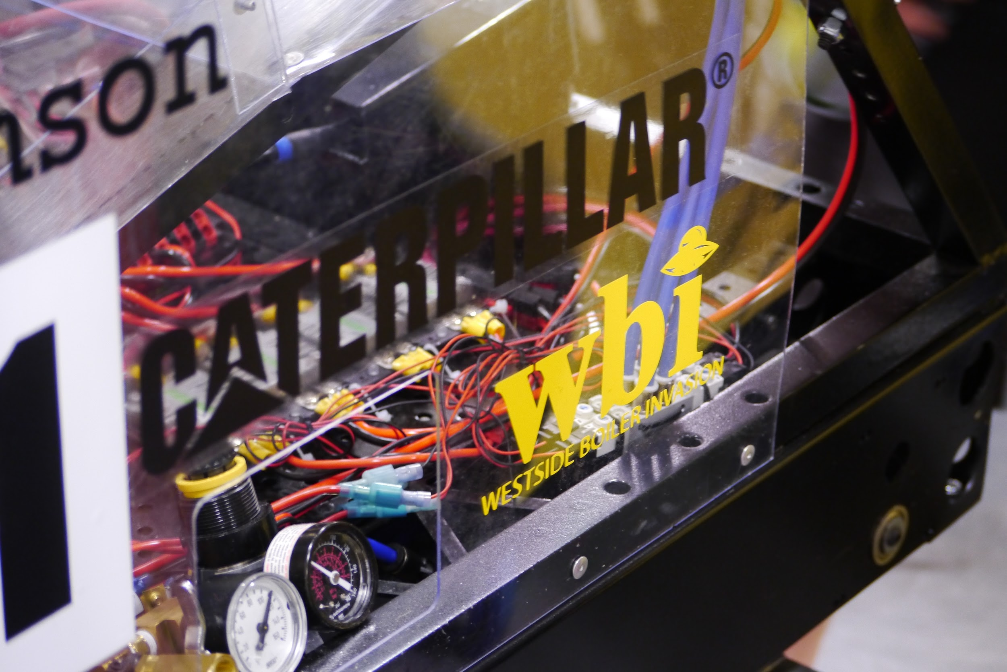
About Us
FIRST Team 461: Westside Boiler Invasion
What We Do
FIRST Robotics Competition
FIRST Tech Challenge
FIRST Lego League Mentoring
Spreading STEM in our community
FIRST
For
Inspiration and
Recognition of
Science and Technology

Slide 3
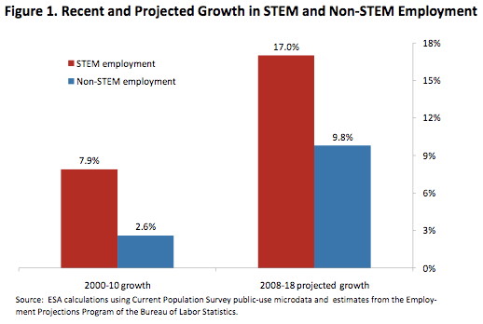
What is STEM?
7.6 million people in America
Job market growing 3x faster
Get paid 26% more
STEM
Science
Technology
Engineering
Mathematics

Slide 4
Youth Robotics Competitions

Slide 5
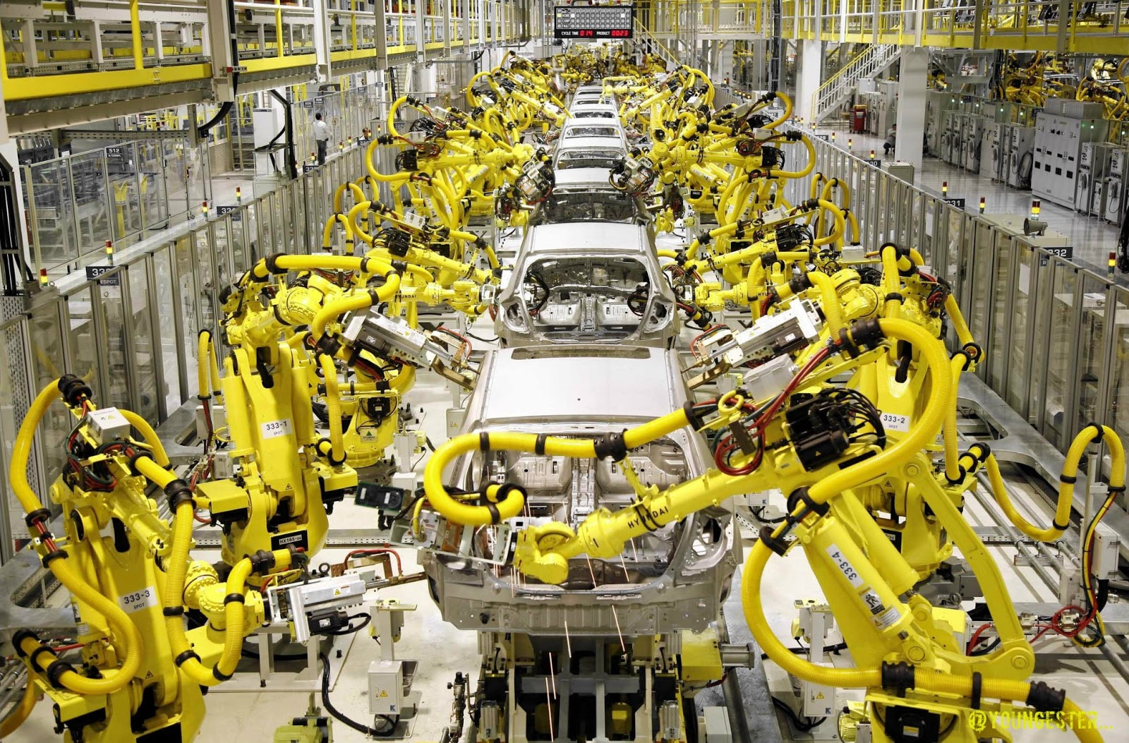
What is Robotics?
Robotics- The branch of technology that deals with the design, construction, operation, and application of robots.
Robots make tasks easier, safer, faster, cheaper, or possible.

Slide 6
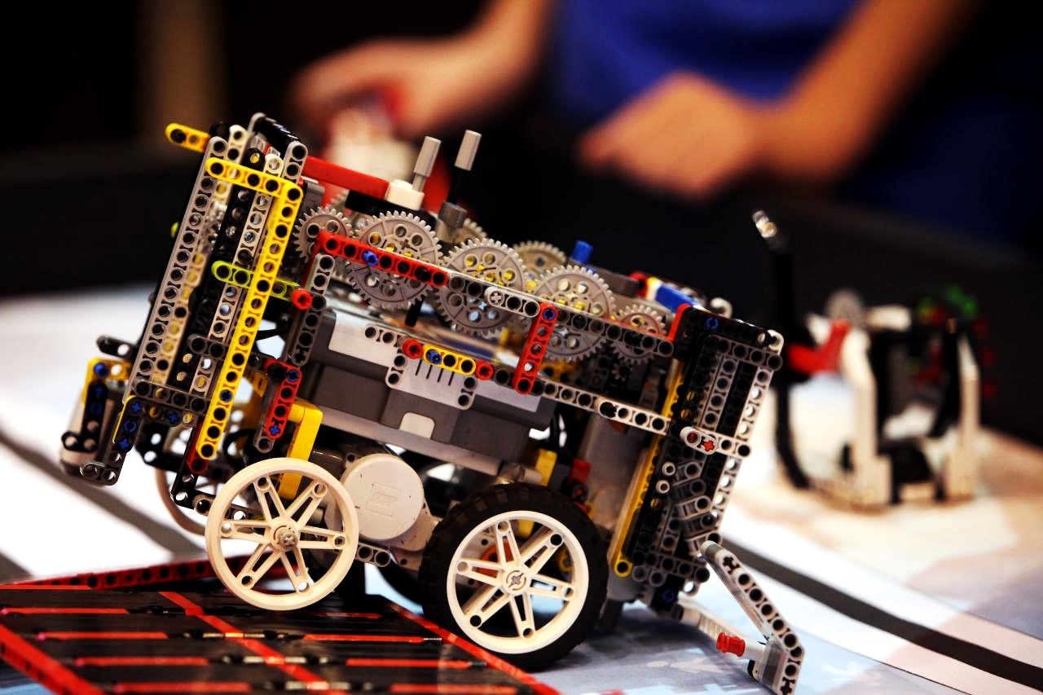
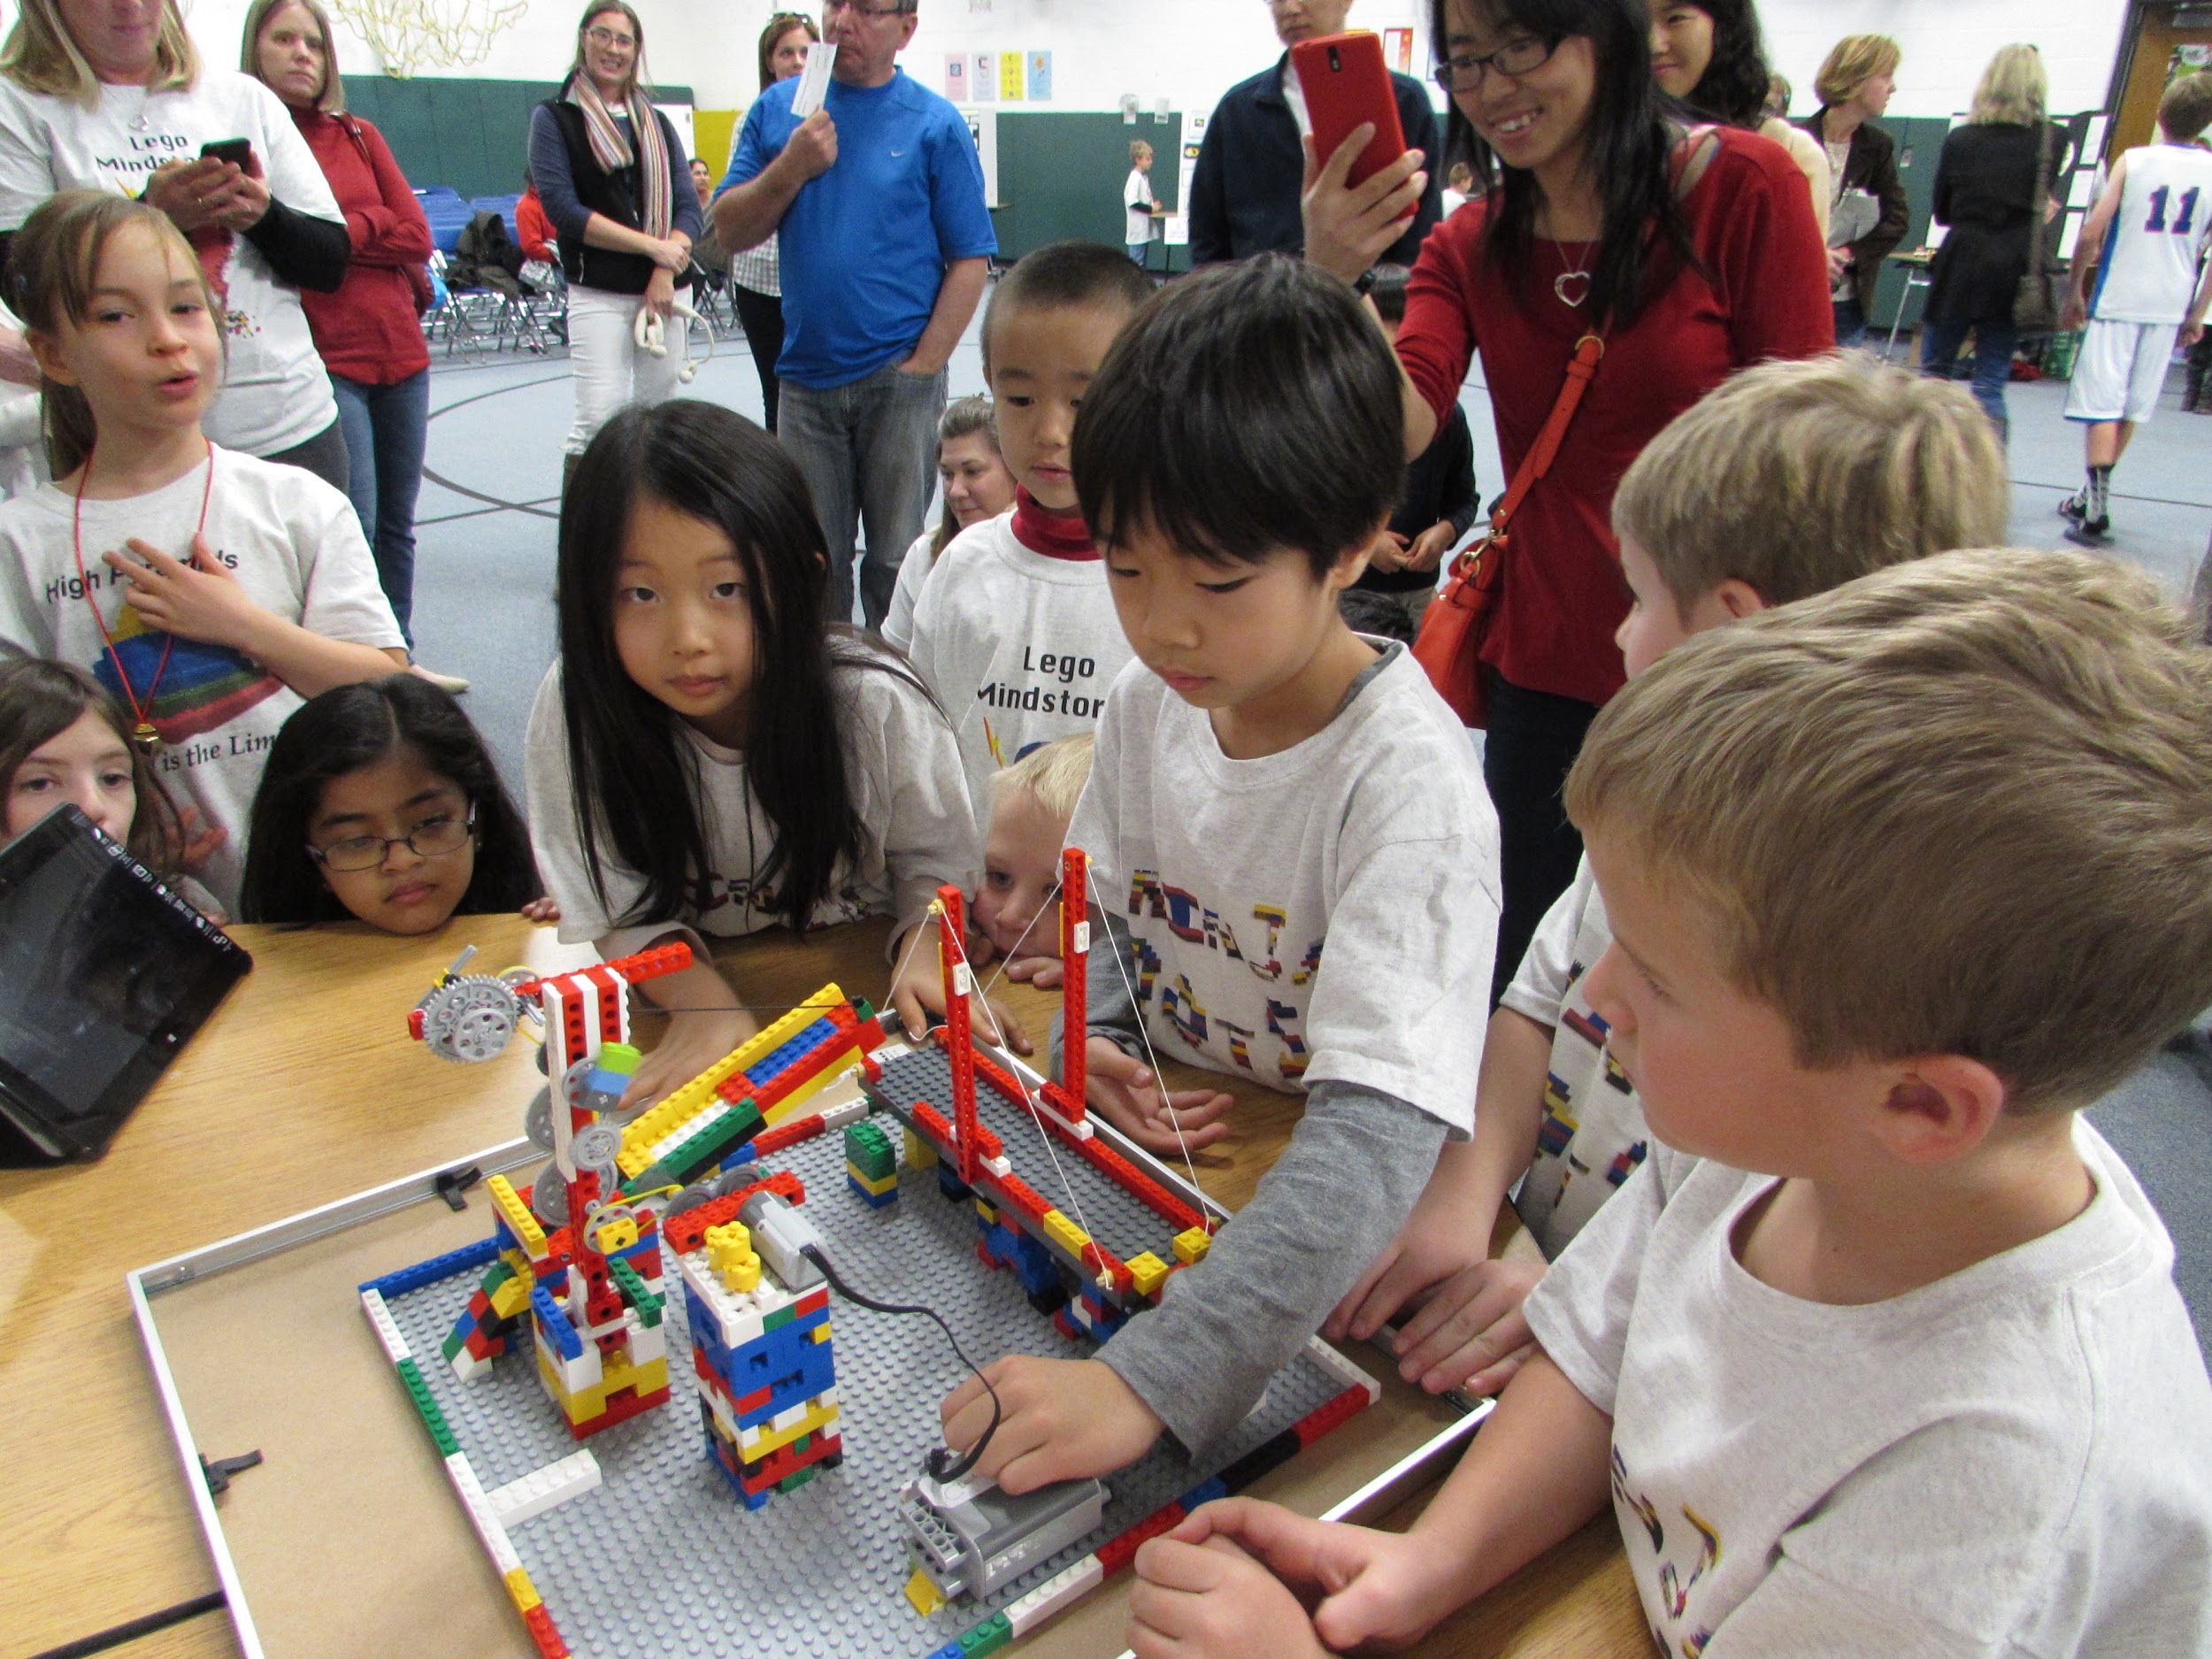
Jr. FLL
FLL
Junior FIRST Lego League
Ages 6-9
4,500 Teams
27,000+ Kids
Full day Competitions
FIRST Lego League
Ages 9-14
26,000+ Teams
267,000+ Kids
Full Day Competitions

Slide 7
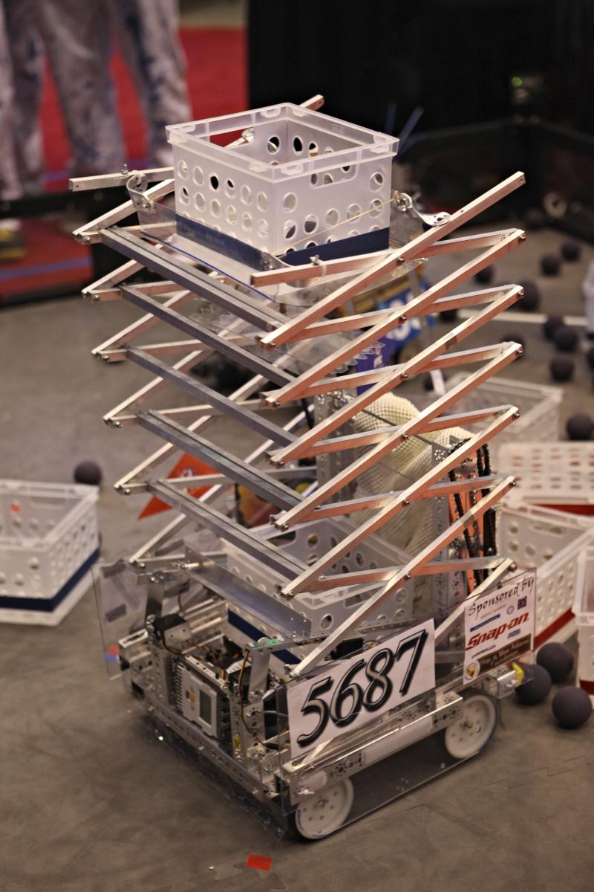
FIRST Tech Challenge (FTC)
A FIRST Competition
Ages 14-18 (High School)
Over 4,500 teams with more than 44,500 students
Full-day Competitions

Slide 8
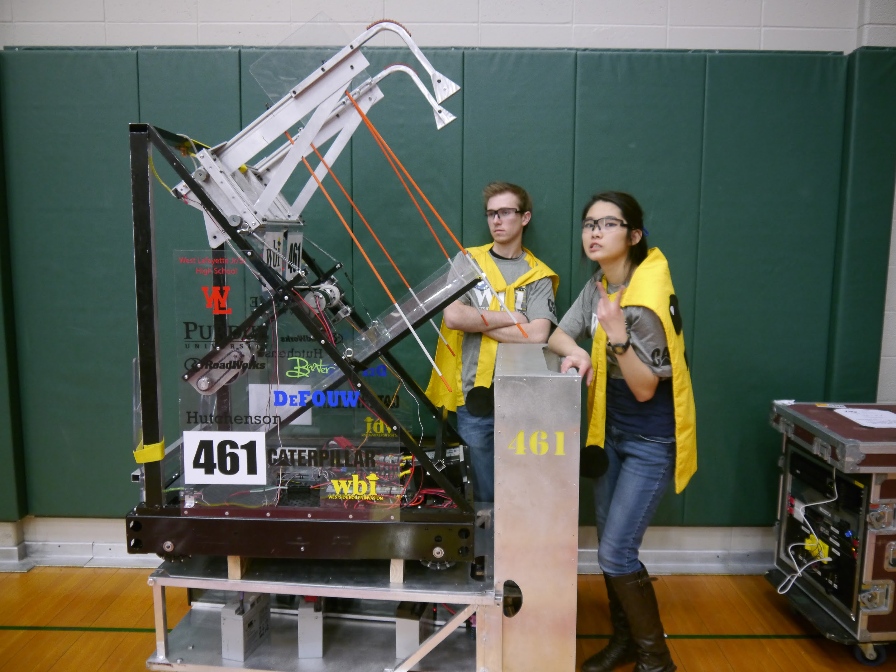
FIRST Robotics Competition (FRC)
Part of the FIRST Program
Ages 14-18 (High School)
3,000 Teams
75,000 Students
Two Day Competitions
Day 1- Practice and Qualification Matches
Day 2- Qualification Matches, Alliance Selection, Elimination Matches

Slide 9
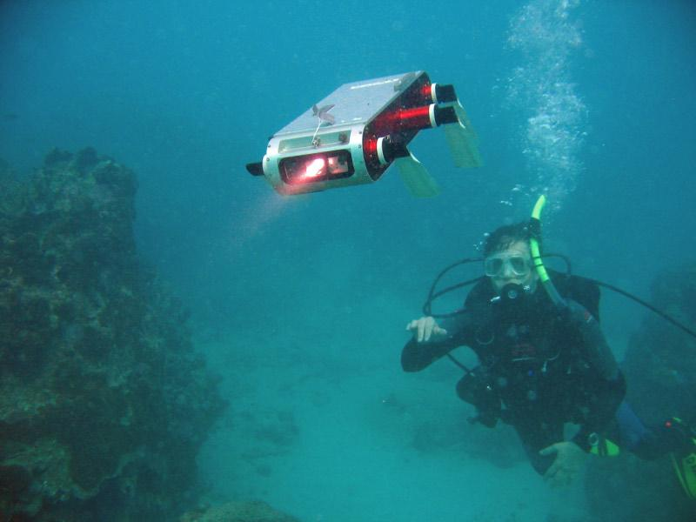
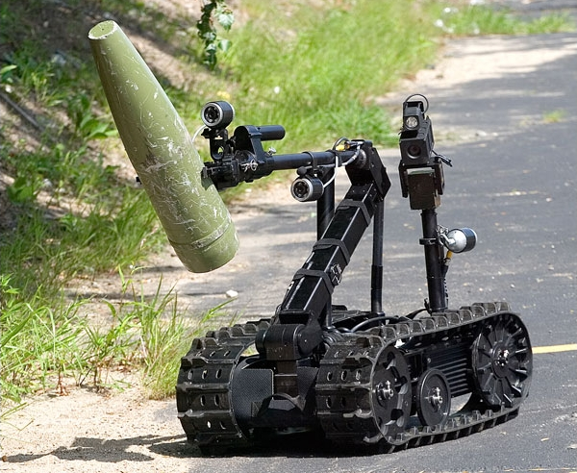
Career Opportunities In Robotics
Exploration
Deep Sea
Space
Military
Fields of Robotics
Mechanical
Electrical
Structural
Biomedical
Industrial

